Slide 1
Bias Training
Faculty
Notes:
Welcome to the Being Human in STEM Faculty Bias Training! We will have instructions and resources for each slide in the speaker’s notes (right here!), so that every presenter can provide a similar experience.
Thank you!!

Slide 2
Instructions for use of Bias Training (Faculty) Slides
These slides were created as a way to change faculty trainings on Bias at the University of Utah. These were intended to be used by staff when training faculty specifically to make training more memorable, engaging, and interactive. As student-led initiative to combat bias, we hope that every professor or instructor understands both the dangers of Bias, and the importance of combating it. Outlined below are our guidelines for adjusting the slides for presentation. We suggest using animations/overlays as you see fit.
As a user, you are allowed to:
Modify the slides
Select slides you want to show (one or many)
Provide personal examples of bias
Add student voices you collect on your own
Ask for discussion
Ask for student involvement
You are not allowed to:
Sell the slides for personal monetary gain
Modify student voices
Modify data
For more information about the slides, please contact:
claudia.degrandi@utah.edu (Dr. Claudia De Grandi (Lead-instructor of the course SCI 3900/HONOR 3990)

Slide 3
Table of contents
01
02
03
04
Being aware
Influence
What is bias?
Do I have bias?
You have an impact on both students and other faculty
Strategies
Conclusion
What can we do to reduce bias? What can you do to work on your own bias?
What did we learn?
Notes:
Explain that here are the table of contents. Allow participants several seconds to look through before continuing.

Slide 4
Imagine…
There was a cheating scandal in your class.
A student posted the answers to one of the assignments on Chegg, and of course people copied the same exact thing.
Notes:
Read this slide out loud to the group. Give them several seconds to think, then ask all participants who are able to stand up. Move to the next slide.

Slide 5
Question for you
What race, gender, etc. did you imagine that student?
Notes:
Read this slide aloud as well. Then ask participants to sit down if they imagined either of the students as Black. Then if either of the students were Native American. Then if they were Asian or Indian. Then if either were Hispanic/Latinx. Finally ask if the students were white.
All participants should be sitting, but if not, ask them to be seated.
Tell them that the purpose of this event is to have them question why the race or gender that came to mind was the one that came to their mind specifically. These instantaneous judgements are examples of implicit/unconscious bias.

Slide 6
01
Being aware of your own bias
Notes:
Read this aloud briefly. Ask the participants if they have heard of bias before and if they can provide a definition of bias or implicit/unconscious bias. Call on one participant who may raise their hand, or cold call someone you trust if no hands were raised.
Affirm them, then move on to the next slide.

Slide 7
Implicit/Unconscious Bias:
“Tendency to make judgements based on prejudice and assumptions, rather than indisputable facts and data.”
^{-Joe Caccavale}
The fact that it is implicit/unconscious doesn’t make it ok.
Implicit bias is bias.
For this training, we are going to refer to implicit bias as “bias.”
We all have implicit bias and it is our job to be aware of it and work on it.
Definition of Implicit Bias LINK
Notes:
So, what is implicit bias? (definition) During this presentation/workshop, we will be referring to implicit/unconscious bias as bias, because it is simply bias.
The fact that it is unconscious, doesn’t justify the actions that we may commit that can be harmful or hurtful to others. It is our job to be aware of it and actively work on it.

Slide 8
02
Influence
You have an impact!
Notes:
Read this aloud briefly. Ask the participants if they have heard of bias before and if they can provide a definition of bias or implicit/unconscious bias. Call on one participant who may raise their hand, or cold call someone you trust if no hands were raised.
Affirm them, then move on to the next slide.

Slide 9
You have an impact!
As a friend, peer, coworker and especially as a professor/instructor, you have a great influence on others!
Notes:
Read this slide aloud.
Then ask if participants have any specific experiences they’re comfortable sharing regarding experiences with implicit/unconscious bias in their classrooms. Call on 1-2 participants.

Slide 10
Personal statements
Each of the following slides contains a personal statement given to us by students of the University of Utah when asked if they had experienced/witnessed bias.
These were collected during Spring ‘23.
Notes:
Read aloud before proceeding.

Slide 11
“Yes I have, I feel like a lot of bias is often unspoken or not as clear unless you are present in the situation yourself. As a student who identifies as female and is a student in STEM I often face bias in STEM classes specifically labs from my male peers where my thoughts don't hold as much "weight" as my fellow male peers, in things such as the steps we should take next.”
-Biology Student at the U of U
Notes:
Read slide aloud.

Slide 12
“Growing up, I absolutely did. In middle school and high school I was frequently shunned for “being a try hard” at school (I wasn’t, academics just came fairly easy to me) whereas the boys who did well in school were not (even though they were supposed “try hards”, which is a weird insult in the first place). In college, I haven’t particularly noticed any bias, but I also am not in class with a small group of the same people daily. It definitely feels like people don’t trust me when it comes to computer science, and my TAs seem somewhat surprised when I know answers to questions in that class.”
- Computational Physics Student at the U of U

Slide 13
03
Strategies
Here’s how to get started!
Notes:
Read this slide aloud, saying “part 2: influence” or something similar.

Slide 14
Strategies for Yourself
Imagine a different scenario
Reflect on past experiences
Seek to use inclusive language
“Would [I/they] have acted differently if the other person had a different identity?”
What could you have done differently in that scenario that could have prevented bias?
Avoid generalizations and stereotypes.
Notes:
Read most of this slide and allow time for participants to read the slides themselves. Then when read, prompt the participants by asking if they have used any of these strategies before, or if they could envision a scenario where those strategies may come into play.
Please reference the below resources to better understand implicit bias and strategies to negate biases.
Resources for recognizing biases:
Strategies for Countering Unconscious Bias in the ClassroomNAFSAhttps://www.nafsa.org › ie-magazine › strategies-count…
https://www.idealist.org/en/careers/unconscious-bias-recognize

Slide 15
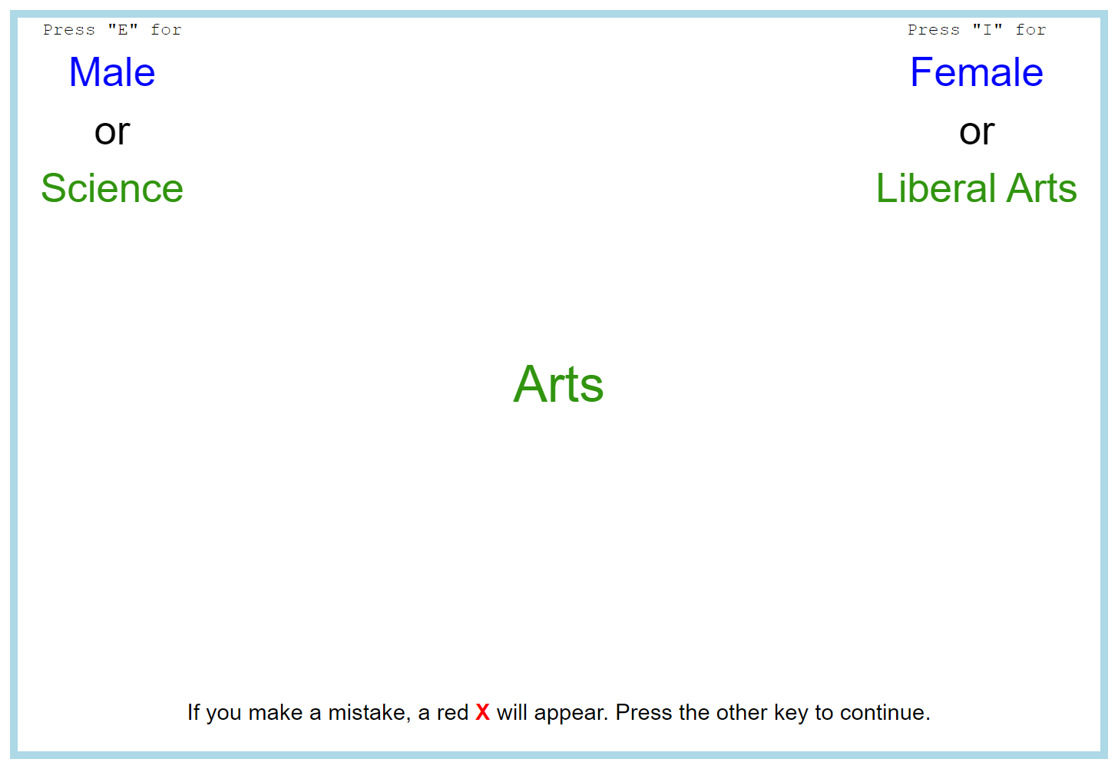
Strategies for Yourself
Take the Implicit Association Test (IAT) from Harvard University:
Fast-paced test
Press “I” for “Female or Liberal Arts”
Press “E” for “Male or Science”
There are other variations it tests you on
There are tests for:
Racism
Classism
Leadership
Gender and Career
Gender and Science
Many more
https://implicit.harvard.edu/implicit/selectatest.html
Notes:
Introduce the Implicit Association Test and prompt others in the class to take it. Think about sending a follow-up email after the class/event that includes the link so that the audience has easy access to it. If people will have their laptops with them, have everyone take the test as part of the presentation (it takes about 5-10 minutes).
Please take prep time to take the test yourself and use that experience to inform your presentation.

Slide 16
Strategies for the Classroom
Consciously Interacting with Diverse Students
Student Bias Training Slide Deck
Anonymous Grading
Grade without identifying information This allows students to be assessed without regards to identity, minimizing biases.
Be purposeful about interacting with and taking questions from students who may be quieter or from backgrounds that are not widely represented
This slide deck can be used in whole or one slide at a time during lectures or other presentations in order to normalize the prevention of bias
Notes:
Read this slide aloud. Explaining anonymous grading and asking if participants have ever used that before. Reference the resources if you are unsure of what anonymous grading is.
Resources for Anonymous Grading:
Anonymous grading: Reducing bias in educational ...The McGill Tribunehttps://www.mcgilltribune.com › opinion › anonymou...
Spend the majority of time explaining the Student Bias Training slide deck. “Students created a collection of slides to be used during lecture, to keep awareness of bias and its effects top of the mind. And yes, that may sound scary or like a way to detract from class time, but the slides can each be taken individually and should not be presented for more than 5 minutes. The goal of this deck was to create Bias mini-lessons to be placed at the beginning of presentations or during break time in class, similar to land acknowledgement slides that head many a presentation at the U, for ease of access.”

Slide 17
– Sonya Renee Taylor, founder of The Body is Not An Apology global movement
“Systems do not maintain themselves; even our lack of intervention is an act of maintenance. Every structure in every society is upheld by the active and passive assistance of other human beings.”
Notes:
Read this slide aloud.

Slide 18
04
Conclusion
Let’s wrap it up!
Notes:
Read Aloud.

Slide 19
To summarize…
Self-awareness | How can you monitor yourself for bias on a regular basis?
Awareness | What is (implicit) bias and how does it impact individuals, especially students?
Statements | What else are people not saying about their experiences with bias?
Influence | How can faculty influence other faculty and students to minimize bias?
Strategies | What action can faculty take on to better the environment of their classes, lectures, etc. and what they can do to work on their implicit bias.
Notes:
Read through this slide. Afterwards, ask the participants what the most surprising or impactful thing that they learned was. Call on 2-3 persons. Thank them for their answers.

Slide 20
These are some of the resources that had the most impact on us
https://www.ted.com/talks/valerie_alexander_how_to_outsmart_your_own_unconscious_bias
This is a TED Talk that really helped us in being aware of our own implicit biases.
https://www.insidehighered.com/views/2021/05/20/how-make-implicit-bias-training-campuses-truly-effective-opinion
This is an article on what to take into consideration while designing a workshop on Implicit Bias.
Notes:
Suggest other resources for further learning.

Slide 21
References
Caccavale, Joe. “What's the Difference between Implicit Bias and Unconscious Bias?” Leading Recruitment Software, Applied, 7 Dec. 2020, https://www.beapplied.com/post/difference-between-implicit-bias-and-unconscious-bias#
Bias Team, L.R.(2023). Effects of Bias [Personal Statements]. HSTEM’23. https://docs.google.com/forms/d/e/1FAIpQLScB4SA1qjBNB2gaMH-cepwOOG8m4mWuuy6TGNq_NBZIASCx2Q/viewform?usp=sf_link
SPECIAL THANKS TO:
The instructors of the class SCI 3900/HONOR 3990 “Being Human in STEM 2023” for all of their support, help, and guidance to make this possible.
Notes:
Show these references, then thank the audience for participating and listening to the presentation.

