Slide 1
Bias Training Students

Slide 2
Instructions for Use
The choice to present these slides to your class is completely optional. As student led initiative to combat bias, we hope that every professor or instructor understands both the dangers of bias, and the importance of combating it. You have an incredible opportunity to spread awareness to your students.
As a user, you are allowed to:
Modify the slides
Select slides you want to show (one or many)
Provide personal examples of bias
Add student voices you collect on your own
Ask for discussion
Ask for student involvement
Distribute the slides
You are not allowed to:
Sell the slides for personal monetary gain
Modify student voices
Modify data
For more information about the slides, please contact:
claudia.degrandi@utah.edu (Dr. Claudia De Grandi (Lead-instructor of the course SCI 3900/HONOR 3990)

Slide 3
Instructions for Use (Continued)
We suggest that the following slides be paired together when presented to the class (page number is located on the bottom right-hand side of the slides.).
5 and 6
7 and 8
13 and 14 OR 15
16 and 17
18 and 19
22 and any of the quotes that follow and 23
Follow up showing the slides/information you pick with 36
We suggest that you pick at least one or more slides from each of the sections (each section is separated by a blue colored slide). It is most effective to select at least one from each section to show your class, however you do not have to. Do not feel required to show more than one from each section or even any from a section. The purpose of the slides is to provide you with the material to include onto your own slides, or to have a collection of slides to briefly show a few of to your class.
Refer to speaker notes for information on how to most effectively present the material.

Slide 4
Section 1
Interactive Hooks

Slide 5
Imagine a…
Scientist
CEO
Lawyer
Janitor
Server
Doctor
Professor
Nurse
Pilot
Notes:
Read out loud, “Imagine a…” and the listed examples. Allow for time to reflect. Feel free to focus on careers that match your course e.g. for STEM majors focus on “imagine a scientist, imagine a mathematician, imagine a doctor, etc.”

Slide 6
Did You Imagine Me?
Notes:
Emphasize how oftentimes our biases are unconscious. We often aren’t even aware how ingrained our biases are. Allow for students to reflect and discuss if you see fit.

Slide 7
Have you ever experienced bias?
Notes:
You can read the text or allow time for students to read it.

Slide 8
Have you ever acted with bias, even unconsciously?
Notes:
Emphasize how oftentimes our biases are unconscious. We often aren’t even aware how ingrained our biases are. Allow for students to reflect and discuss if you see fit.

Slide 9
Section 2
Definitions of Bias

Slide 10
What is Bias?
Bias is a form of prejudice and stereotyping against someone due to their personal identity.
Oftentimes this can be unconscious.
Notes:
Read the text. Add your on your own definition of bias if you see fit.

Slide 11
Dictionary Definition of Bias
A personal and sometimes unreasoned judgment : prejudice
Merriam-Webster’s Collegiate Dictionary (10th ed.). (1999). Merriam-Webster Incorporated.
Notes:
Read the text. Add your on your own definition of bias if you see fit.

Slide 12
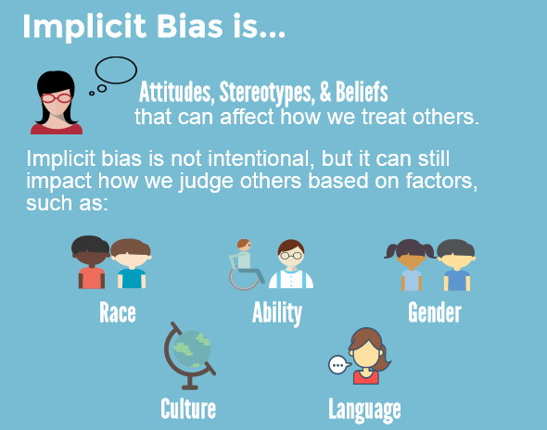
Preventexpulsion.org, 2013, preventexpulsion.org/1g-provide-professional-development-and-ongoing-support-for-all-program-staff-on-culturally-responsive-practices-and-implicit-bias/.
‌
Notes:
Read the text. Add your on your own definition of bias if you see fit.

Slide 13
Section 3
Examples and Statistics of Bias

Slide 14
What is an example of bias in the real world?
Notes:
Read the text, allow students to discuss if you see fit.

Slide 15
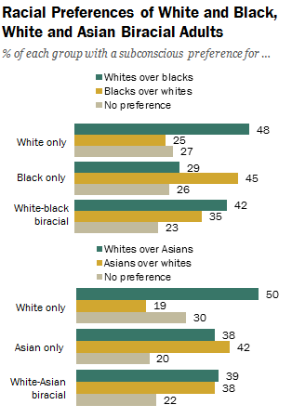
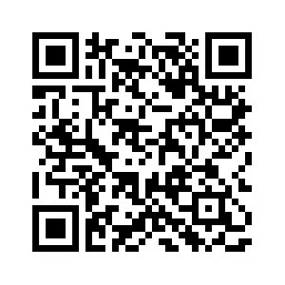
Racial Bias
The following figure is data from an Implicit Association Test done by Pew Research Center to test unconscious biases and preferences for races. The data shows that white identities are on average preferred against both Black and Asian races. This shows that most adults who took the test demonstrated some form of racial bias.
You can take this test yourself.
Project Implicit. “Take a Test.” Harvard, Project Implicit, 2011, implicit.harvard.edu/implicit/takeatest.html.
Notes:
Paraphrase or read the text in its entirety. Allow time for students to scan.

Slide 16
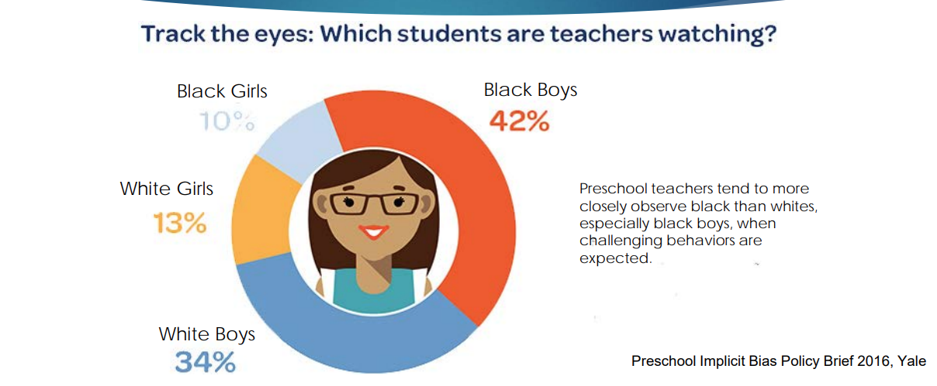
Bias in Pre K-12 Schools
Notes:
Paraphrase or read the text in its entirety.

Slide 17
Students can show bias against professors
Notes:
Read the text, allow students to discuss if you see fit.

Slide 18
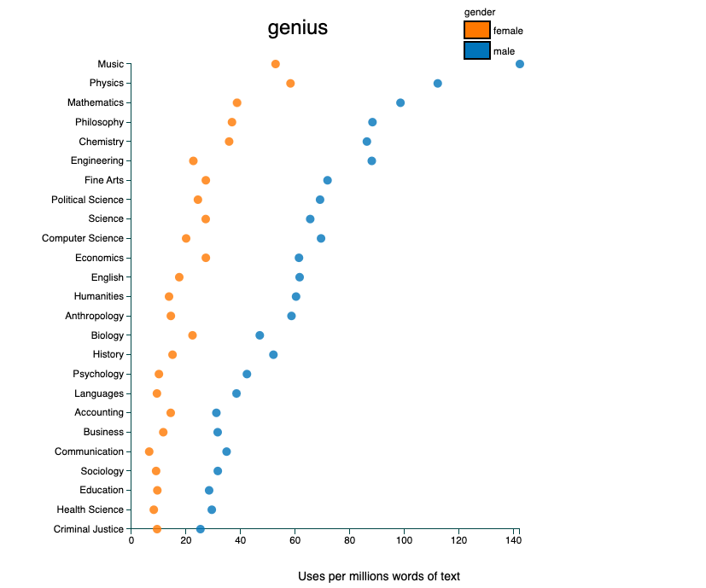
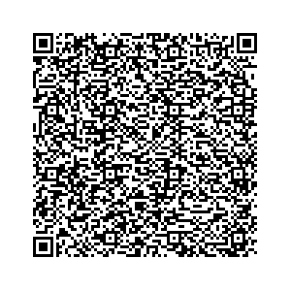
Students Exhibit Bias as Well
This is a new tool that allows the user to search up specific words in a interactive chart that explores the words used to describe male and female teachers in about 14 million reviews from RateMyProfessor.com.
https://benschmidt.org/profGender/
Notes:
Read the text or paraphrase. We recommend that you click on the link below and type in a few words, you could even ask the class if they have any words they would like to try. You can also instruct the students to scan the QR code and allow them to do it themselves. Emphasize how this is an example of bias in the academic space. This is the link: http://benschmidt.org/profGender/#%7B%22database%22%3A%22RMP%22%2C%22plotType%22%3A%22pointchart%22%2C%22method%22%3A%22return_json%22%2C%22search_limits%22%3A%7B%22word%22%3A%5B%22his%20kids%22%2C%22her%20kids%22%5D%2C%22department__id%22%3A%7B%22%24lte%22%3A25%7D%7D%2C%22aesthetic%22%3A%7B%22x%22%3A%22WordsPerMillion%22%2C%22y%22%3A%22department%22%2C%22color%22%3A%22gender%22%7D%2C%22counttype%22%3A%5B%22WordCount%22%2C%22TotalWords%22%5D%2C%22groups%22%3A%5B%22unigram%22%5D%2C%22testGroup%22%3A%22C%22%7D

Slide 19
What is the benefit of reducing your unconscious biases?
Notes:
Read the text. Allow for discussion if you see fit. Emphasize how reducing your biases create better academic and career environments.

Slide 20
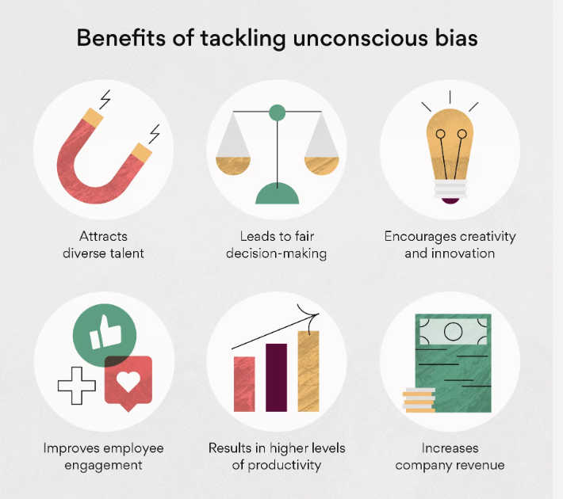
Notes:
Paraphrase or read the text in its entirety.

Slide 21
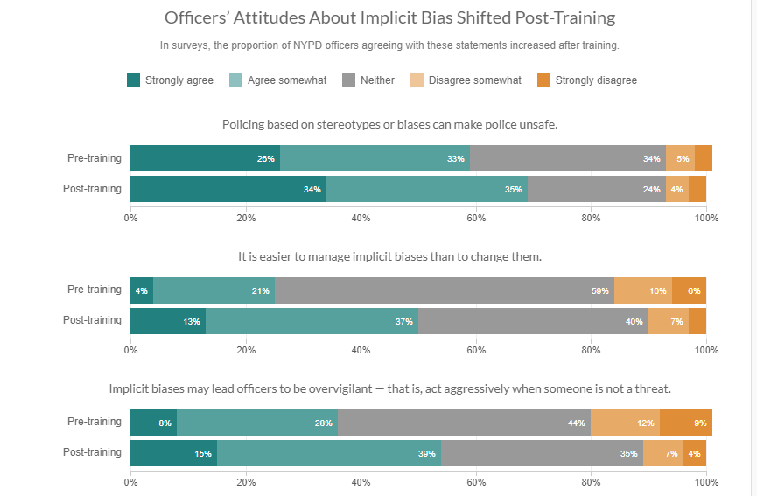
Does Training Work?
A survey conducted by NPR Research in correspondence with The New York Police Department found that the rates of agreement with the 3 statements regarding Implicit Bias increased within various precincts after training was completed .
Implicit Bias Training NYPD. NPR, 2020
Notes:
Paraphrase or read the text in its entirety.

Slide 22
Section 4
Quotes about Bias

Slide 23
Quotes from Students at the University of Utah
Notes:
Read each quote or allow time for students to read the quotes on their own. It is also a possibility that you can pick multiple quotes to put on one slide to show your students. Our goal is to show real life direct quotes to students. This is impactful. If you see fits, allow for discussion or time to reflect, ask students how they can better treat their peers. Emphasize that this is not based on just gender, race, sexual identity, etc. Everyone can experience bias, and everyone is biased.

Slide 24
-Criminology Student at the U of U Graduating in 2026
“Everyone experiences bias and stigma, even the majority at times. While it may be worse for some, it’s a possibility for anybody”

Slide 25
-Biology Student at the U of U
“Yes I have, I feel like a lot of bias is often unspoken or not as clear unless you are present in the situation yourself. As a student who identifies as female and is a student in STEM I often face bias in STEM classes specifically labs from my male peers where my thoughts don't hold as much "weight" as my fellow male peers, in things such as the steps we should take next.”

Slide 26
-Psychology/Family, Community & Human Development Student at the U of U
Yes, my peers don’t really like to understand how badly Chronic PTSD affects individuals, especially if it was started at a young age. It affects all aspects of my daily life and for me it mimics ADHD, so I tend to talk a lot or be “a lot to be around”. I don’t have a lot of friends due to that mental health barrier..and some [classmates] like to give me the side eye when I talk or treat me like I’m stupid, or like I have no clue what I’m talking about. It is funny for me because I am very good at most things in academia —just not math— so for me it’s just another way to prove myself. I don’t like to look to deep into biases and bullying when it comes to other people doing it to me, cause honestly at the end of the day; yes it hurts, but I know it’s not true and I can prove them wrong

Slide 27
-Computational Physics Student at the U of U
Once again, growing up I absolutely did. I was constantly held to a higher standard of behavior that boys were not because they “were just being boys,” and my teachers admonished me for being arrogant and abrasive while boys were called confident and bold. As far as college, I’m not sure if this is bias per se, but it is definitely gender-based and worsens my class experience. I went to ask a professor for an extension, but the entire time I was talking to him he was staring at my chest. I stared directly in his eyes the whole time, but he just kept doing it. I ended up not taking the option for the extension, as I was so uncomfortable I just wanted to stop talking to him as soon as I could.

Slide 28
-Psychology/Family, Community & Human Development Student at the U of U
“It’s not that big of a deal honestly, but due to either my Chronic PTSD or dyslexia (haven’t been able to get testing done to figure out which it is, due to biases of being a woman with health problems) but basically I’m judged because I cannot do math. I’ve tried tutoring, professor drop-ins, everything. It’s been like this since fourth grade and I don’t know why but professors -sometimes faculty- make me not want to go to class or get help due to the sighs, or the lack of wanting to help. Again it’s not that big of a deal and because I’m a psych major I won’t deal with math classes next year..no one in the medical world will help either. I’ve tried mental testing twice, no one will give me any straight forward answers; but I can ride it out, i am tough; I have a C right now so I am okay.”

Slide 29
-Chemical Engineering Student at the U of U
“In my Chem E lab, I’ve been in a group with two guys, and they gave me low skill tasks. I don’t know if it was intentional, but because I was the only woman in the group, it felt pretty demeaning.”

Slide 30
-Computational Physics Student at the U of U
Growing up, I absolutely did. In middle school and high school I was frequently shunned for “being a try hard” at school (I wasn’t, academics just came fairly easy to me) whereas the boys who did well in school were not (even though they were supposed “try hards”, which is a weird insult in the first place). In college, I haven’t particularly noticed any bias, but I also am not in class with a small group of the same people daily. It definitely feels like people don’t trust me when it comes to computer science, and my TAs seem somewhat surprised when I know answers to questions in that class.

Slide 31
-Geography Student at the U of U Graduating in 2024
“Many students think my opinion is less valuable because of my skin color, gender, and orientation—all for traits I can’t change”

Slide 32
-Biology Student at the U of U
“Religion: when I used to be apart of the LDS church, there was always this look people would give me when I told them I was Mormon. It was a look that was like judgment but at the same time contempt, it was as if the person instantly say me as inferior and abnormal. It didn’t matter how much they liked me as a person or how smart I was, I was the Mormon girl and that’s all that people seemed to see. They often made comments and would ask questions but often in an accusatory way.”

Slide 33
Section 5
Techniques to Reduce Bias

Slide 34
How to Reduce Your Bias
01
02
03
04
Reflect
Seek Advice
Listen
Adjust
Self-reflection and awareness of your biases is the first step
Exposure to diverse perspectives, seek advice when making decisions or questioning your biases
Practice active listening, be empathetic, try to genuinely learn about other ways of thinking
Recognize when you are making an assumption based on a stereotype and actively avoid it
Notes:
Read these bullet points aloud, at least read the bolded text and allow for students to read the smaller words themselves. If including onto your own slide templates, pick which techniques you find work the best.

Slide 35
How to Reduce Your Bias
05
06
07
08
Learn
Respect
Act
Repeat
Recognize when you have unconsciously acted with bias and learn from and reflect on it
Speak using inclusive language, respect others when you talk and avoid stereotyping and generalizations
Widen your social circle
Training your bias is not a one time thing, continue to work on it and update to new social climate issues
Notes:
Read these bullet points aloud, at least read the bolded text and allow for students to read the smaller words themselves. If including onto your own slide templates, pick which techniques you find work the best.

Slide 36
Section 6
Resources

Slide 37
Resources
There are resources for possible situations that may arise. These are here to support and help those in need and put a stop to situations that no one should have to endure. Don't be afraid to reach out or report, the U is devoted to making a safe and inclusive campus for everyone.
https://safeu.utah.edu/
https://diversity.utah.edu/initiatives/rbirt/
(Bias Incident Reporting)
Notes:
It is important to follow up with a way for students to report incidences of bias where it is a concern. This is a safe resource for students to visit for help.

